Slide 1

EXECUTIVE BRIEFING
Hospital Management
Analytics
Clinical capacity, financial performance, and patient outcomes.

Slide 2

MACRO OVERVIEW
Key Performance Indicators
4.8K
₹24.5M
4.2
₹42.6K
Total Patients
Total Billing
Avg Length of Stay
Avg Treatment Cost
Annual facility admission volume.
Aggregate gross revenue generated.
Bed occupancy duration in days.
Per-patient clinical expenditure.

Slide 3

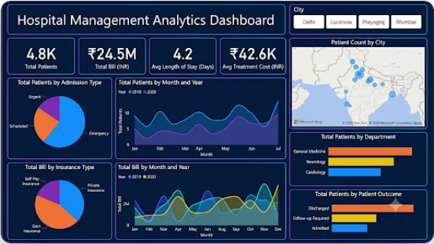



GEOGRAPHIC FOOTPRINT
Strategic Regional Coverage
High density across Delhi and Mumbai.
Growing volume in Lucknow and Prayagraj.
Steady month-over-month admission scaling.

Slide 4
CLINICAL WORKLOAD
Total Patients by Department
General Medicine
Max
Neurology
High
Cardiology
Med

Slide 5



Financial Mix & Insurance
Private Insurance
Self-Pay
Government
Primary driver of gross hospital revenue.
Direct billing across outpatient services.
State-subsidized demographic coverage.

Slide 6







CARE PATHWAY
Patient Outcomes
Admitted
Follow-Up
Discharged
Active clinical management.
Scheduled post-care monitoring.
Successful treatment conclusion.

Slide 7


Empowering Healthcare
with Data
Optimizing clinical capacity and driving operational excellence.

Slide 8


Image Sources
https://images.stockcake.com/public/8/f/d/8fd02691-12dd-4211-b6a1-49f333d12265_large/digital-heart-concept-stockcake.jpg
Source: stockcake.com
https://carat.im/_next/image?url=https%3A%2F%2Fassets.carat-api.im%2Fupload_from_app%2Fpublic%2F20260710%2Fe13ba7a9-986f-4c99-b15e-0815c0b9de38.jpg&w=3840&q=75
Source: carat.im

